Slide 1
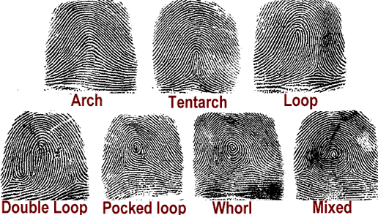
Fingerprints!
Devotion
Our fingerprints never fade from the lives we touch.

Slide 2
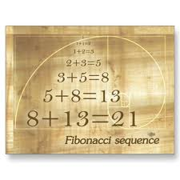
A short video – The Fingerprint of God
http://www.youtube.com/watch?v=-Ibc8sD5sgw

Slide 3
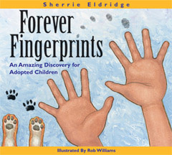
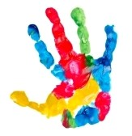
Fingerprints
There is a song by Steven Curtis Chapman that says: I can see the fingerprints of God When I look at you I can see the fingerprints of God And I know its true You're a masterpiece That all creation quietly applauds And you're covered with the fingerprints of God So look around you and see where YOU can see God's fingerprints. Is it in nature? Kids? Animals? Where do you see them?

Slide 4
Fun Trivia Game about Fingerprints -
http://www.funtrivia.com/newflash/trivia.cfm?qid=170308
It was Mark twain who first used the fingerprinting evidence to solve a crime in one of his fictional novels, “Life on the Mississippi” (1883);
Fingerprints are believed to have outnumbered the DNA in the identification process with regards to crime solving and other incident-related cases

Slide 5
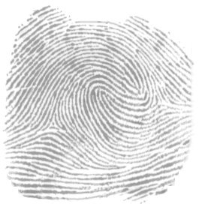
Fingerprint Lesson Plan - dactylography
http://www.reachoutmichigan.org/funexperiments/agesubject/lessons/prints.html
Middle School
Elementary School
http://pbskids.org/zoom/activities/sci/fingerprints.html
http://www.lessonplanet.com/article/art/the-fibonacci-sequence-through-art-lessons

Slide 6
Fingerprint Devotional
Consider for a moment the fingerprints in your life? How are you influencing those around you and what are the ways you are leaving your "mark" on the world? Whether we realize it or not, everything we say and do leaves behind a powerful fingerprint in life, a sign of who we are and what we are about. In fact, the fingerprints we leave behind in life will serve as reliable indicators on what we held true to our hearts and most important in our lives. Without question, our fingerprints truly say a great deal about who we are.

