Slide 1
Royal Books With Regal Applications
-Some ideas on how to use them in your classroom to integrate science and mathematics concepts
By: Cyndi Summers

Slide 2
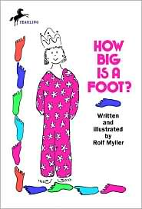
Learning Objectives
Students will:
*create non-standard units
*explore the need for a standard unit of measure
Story Summary
The King demands that a bed be made using measure of his foot, but the carpenter uses his own foot as a measure instead, thereby causing the dimensions to be smaller than expected.
Materials
-foot patterns (12” & 6 “)
-thumb pattern (inch)
-bulletin board paper cut into rectangle shaped beds to be measured using the foot patterns
-glue sticks
Procedure
Read the story and pause to allow the children to brainstorm about why the bed was too small for the queen. Talk about how the foot standard for measuring was made by the use of a ruler. Have the children find out how many feet the beds are by gluing feet on the paper beds. How many thumbs fit on the foot?

Slide 3
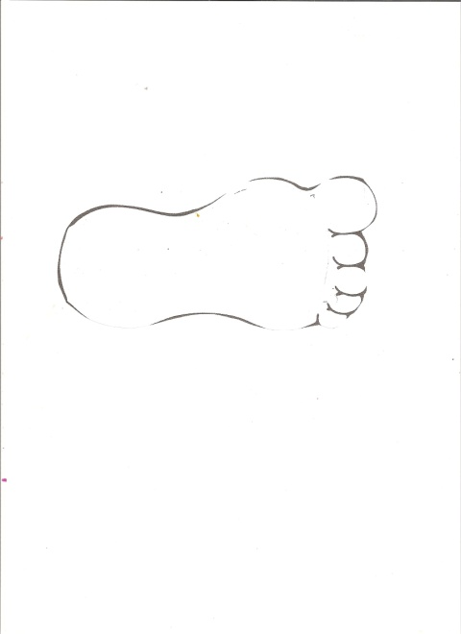
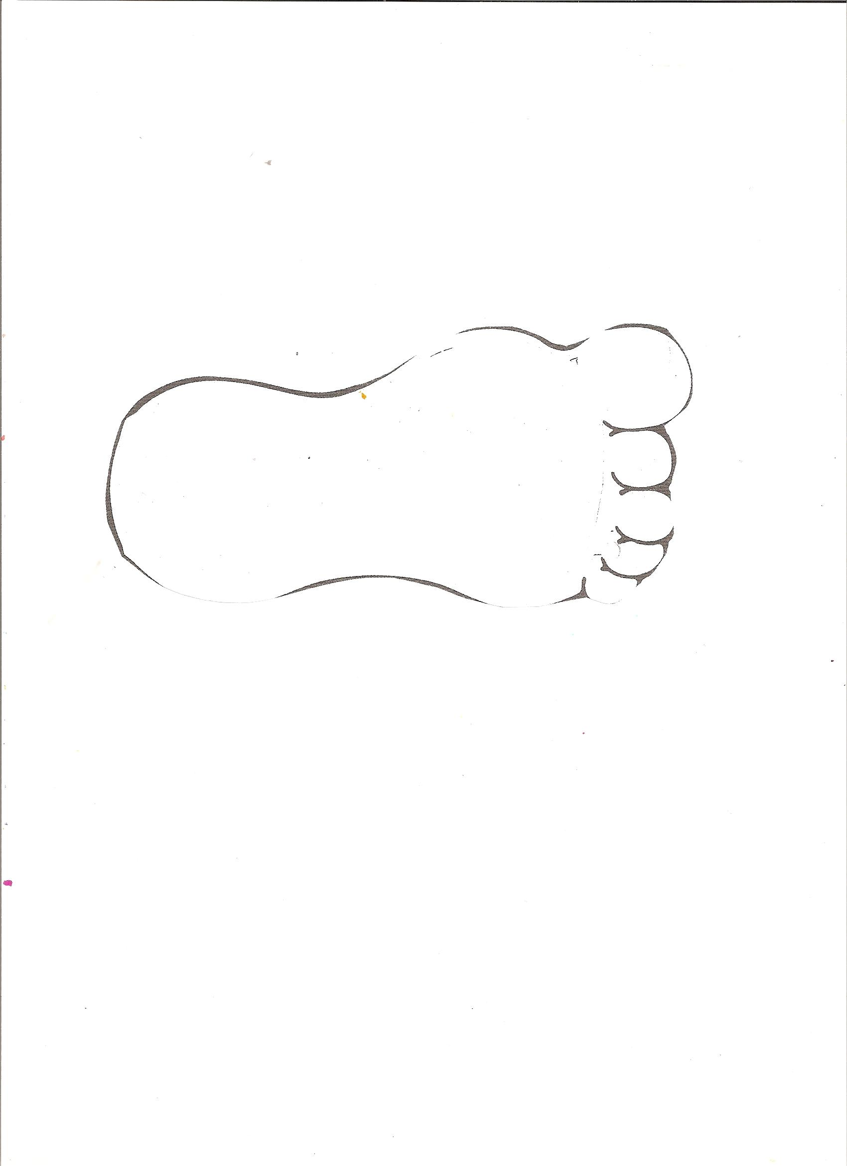
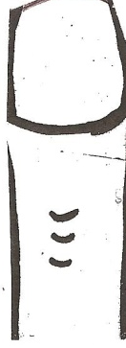
Activity for:
The King’s Foot
Use various sizes of rectangle sheets of bulletin board paper to represent beds. Let the students measure and paste the feet around them.
Line up and paste the thumbs onto the foot. Write the numbers 1-12 onto the thumbnails to notice that there are 12 inches in the foot.

Slide 4
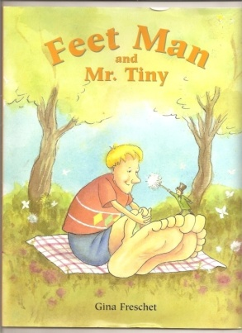
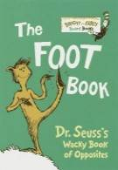
Other books to make connections with for The King’s Foot
Feet Man and Mr. Tiny
This book is a hilarious book that describes many different kinds of feet – gigantic feet, titanic feet, humungous feet , fungus feet, stubby feet, grubby feet, horny feet, and corny feet
Activity-
Mr. Tiny could be used to describe centimeters!
The Foot Book
Activity –
Let the children trace their own feet and decorate them or measure with their feet patterns.

Slide 5
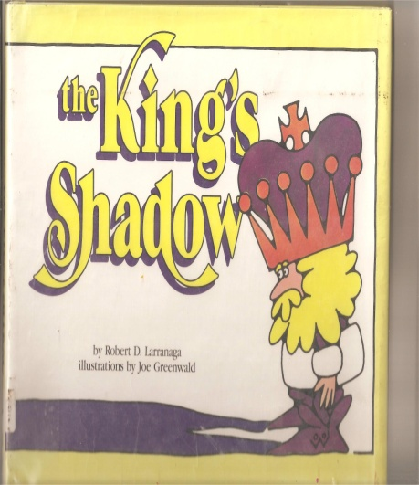
Learning Objectives
Students will:
*Compare and describe features of the day and night sky
*Be able to identify a connection between the direction of the shadow and location of the Sun.
Story Summary
The prince is afraid of his own shadow.
Materials
-flashlight
-ruler
-chalk
Procedure
Read the story and reflect on the shapes of the prince’s shadow.
Go out in the morning and draw a box with chalk where a partner stands. Then, trace the partner’s shadow and write the name in the box. Then go back in the afternoon and have the kids stand in exactly the same place they were that morning. Notice what has happened to the shadow.

Slide 6
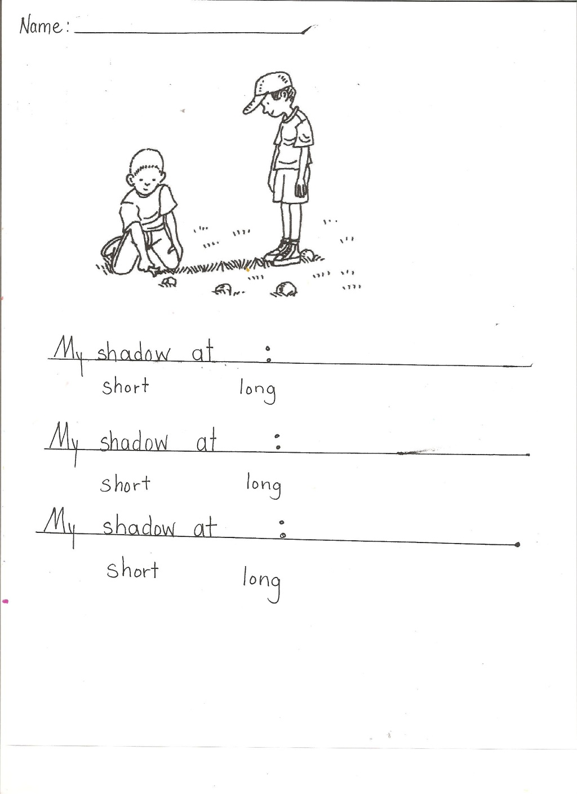
Activity for:
The King’s Shadow
Have a partner use chalk to draw another student’s shadow at different times of the day. Write the time on the shadow. Record the times on the sheet. Circle or measure the length of the shadow.

Slide 7
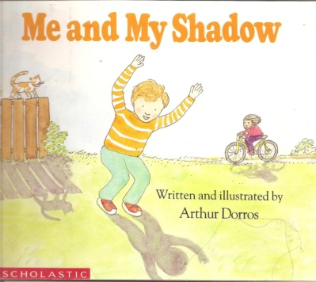
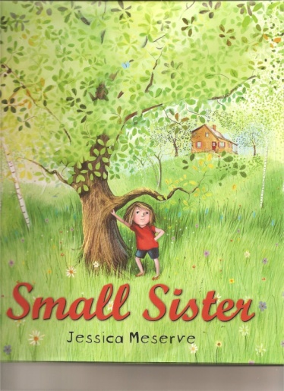
Other books to use with
The King’s Shadow
Me and My Shadow is a non-fiction book that provides a hands-on approach to investigate shadow principles indoors and outdoors.
Small Sister is a fiction book. Small feels as if she’ll never step out of her sister’s shadow.

Slide 8
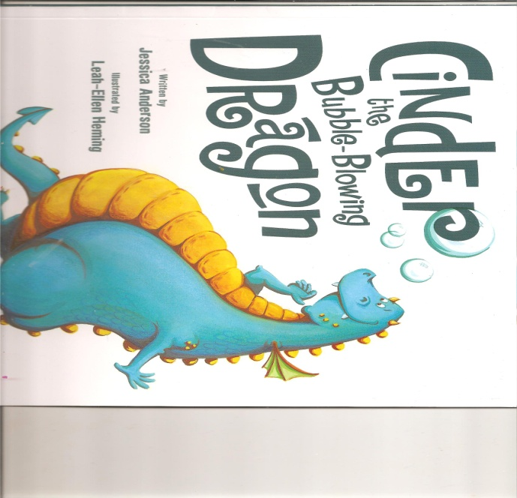
Learning Objectives
Students will:
-Use records and graphs of seasonal temperature changes
-Students will learn how to read from an actual thermometer.
-Students will color the paper thermometer to a temperature
Story Summary
Cinder is a popular dragon with one small problem. Instead of fire, Cinder breathes bubbles. While the King searches for a fire-breathing dragon for his palace, Cinder is sidelined. But, can the bubble-blowing dragon save the day?
Materials
-worksheets of dragons
(Ice, room temperature, fire dragons)
-cup of ice, water, hot water
-thermometers
-red crayons
Procedure
Read the story. Discuss temperature.
Use a thermometer to measure the ice, room temperature water, and hot water. Allow students to color the thermometers on the worksheets.

Slide 9
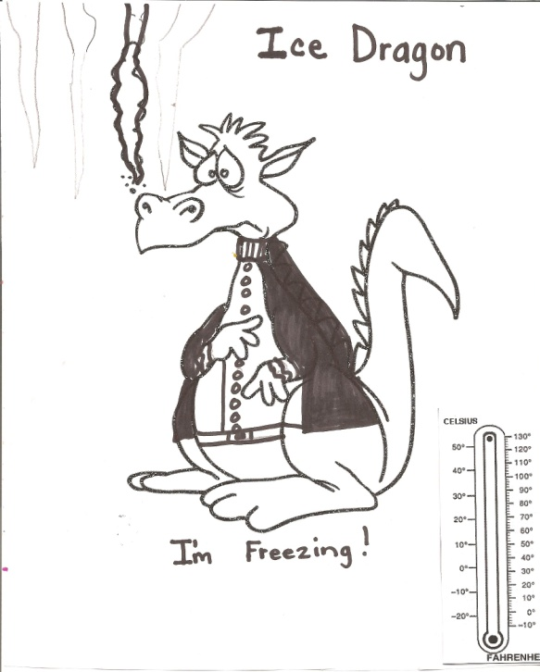
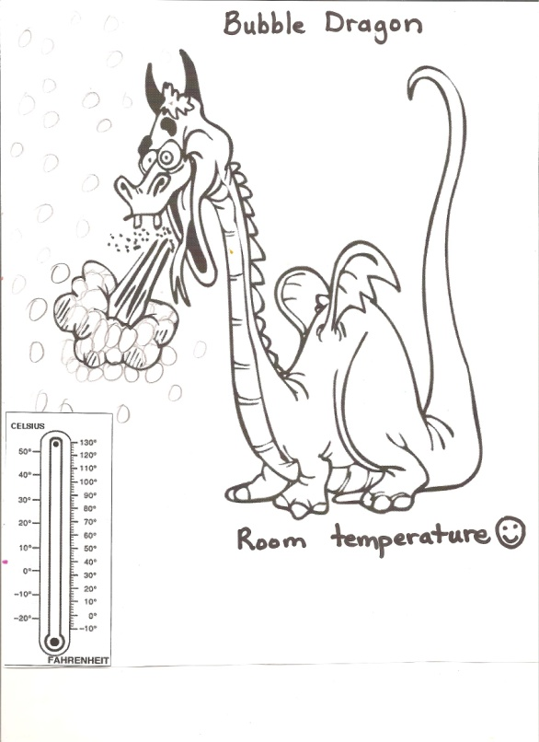
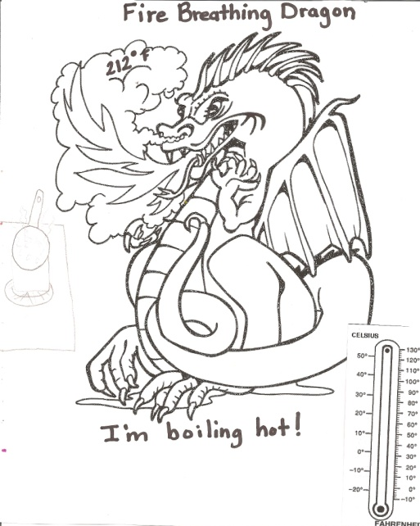
Activity for:
Cinder the Bubble-Blowing Dragon
Color the thermometer the correct temperature.

Slide 10
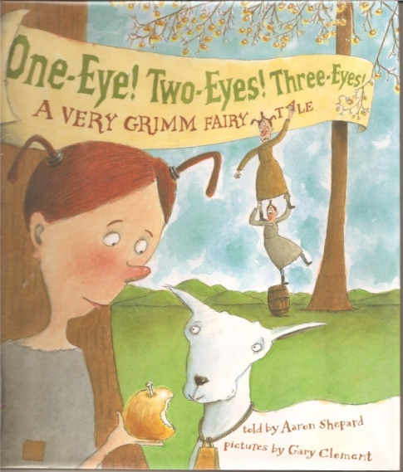
Learning Objectives
Students will:
*be able to distinguish between odd and even numbers
Story Summary
Two-Eyes is different from her sisters and others, because she has just two eyes. She has two sisters. One has one eye and the other has three eyes. She is treated like Cinderella.
Materials
-worksheet of eyeballs
-worksheets of characters with no eyes
-glue sticks
-scissors
Procedure
Read the story and discuss how Two-Eyes had two very odd-ball sisters. Teach the concept of odd and even numbers. Let the students put eyeballs on the characters and tell if they have an odd or even number of eyes.

Slide 11
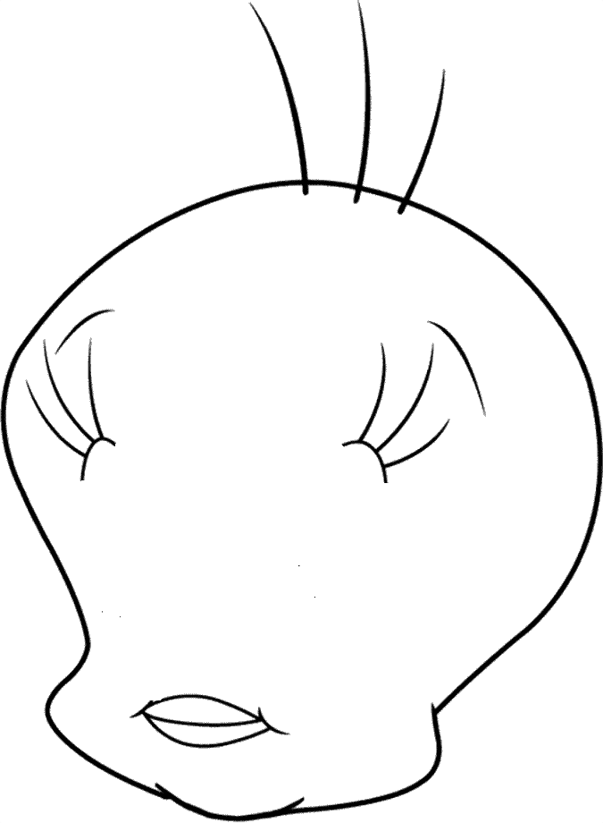
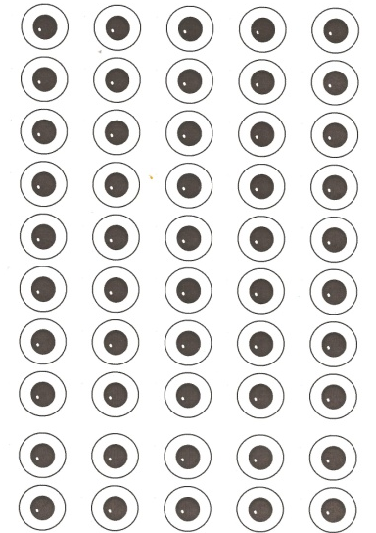

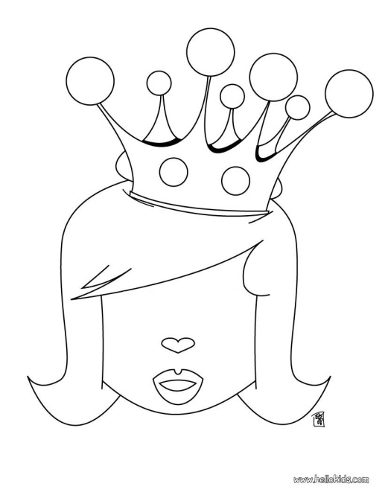
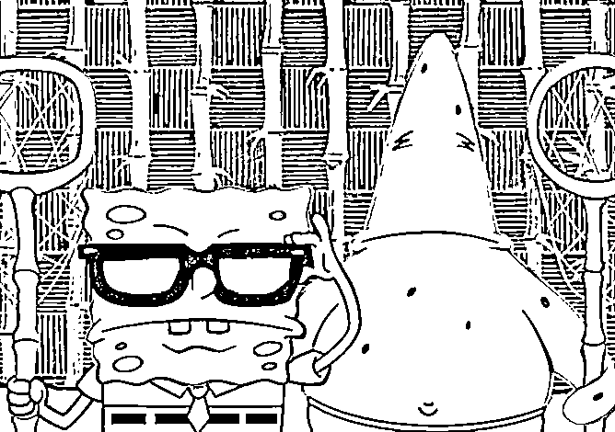
Activity for:
One-Eye! Two-Eyes! Three-Eyes!
Use the eyeballs to make characters with an odd or even number of eyeballs.

Slide 12
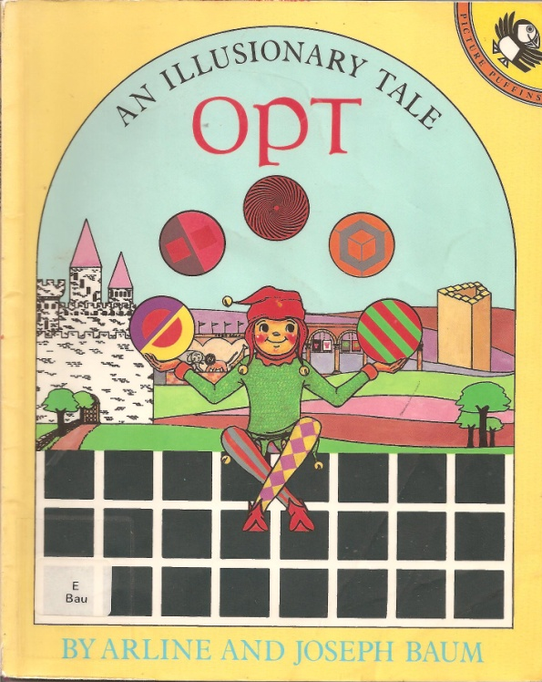
Other books to use with
One-Eye! Two-Eyes! Three Eyes!
Opt is a land full of optical illusions where objects appear and disappear. The illusions will be fascinating to children.

Slide 13
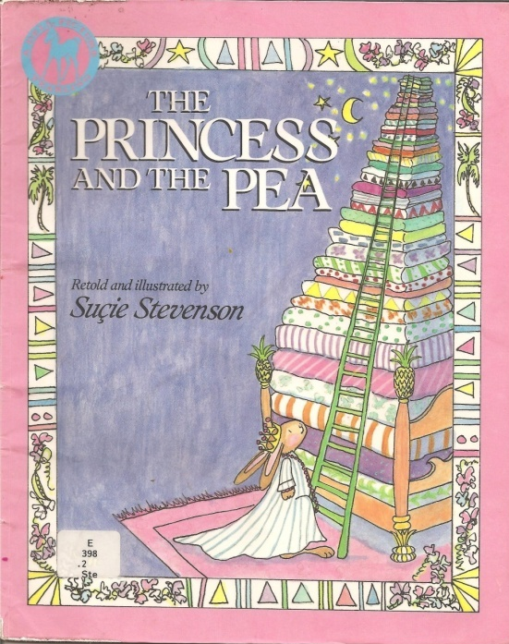
Learning Objectives
*To experimentally measure the strength of a magnet and make predictions on how the strength changes as the distance from the magnet increases, and as the barrier (paper) is built between the magnet and an iron object.
Story Summary
By feeling a pea through many mattresses, a girl proves that she is a real princess.
Materials
-magnet marble and bar or wand
-paper princess pattern
-construction paper cut in half
Procedure
Read the story and discuss how the princess could feel the pea under all the mattresses and quilts. Tape the paper princess to the bar or wand magnet. Predict and count how many pieces of construction paper the magnet can continue to hold the magnetic marble.

Slide 14
Activity for:
The Princess and the Pea
Use one of the paper princess patterns to glue to a magnet. Hold the princess over construction paper to discover how many pieces of paper the magnet can continue to pick up a marble magnet.

Slide 15
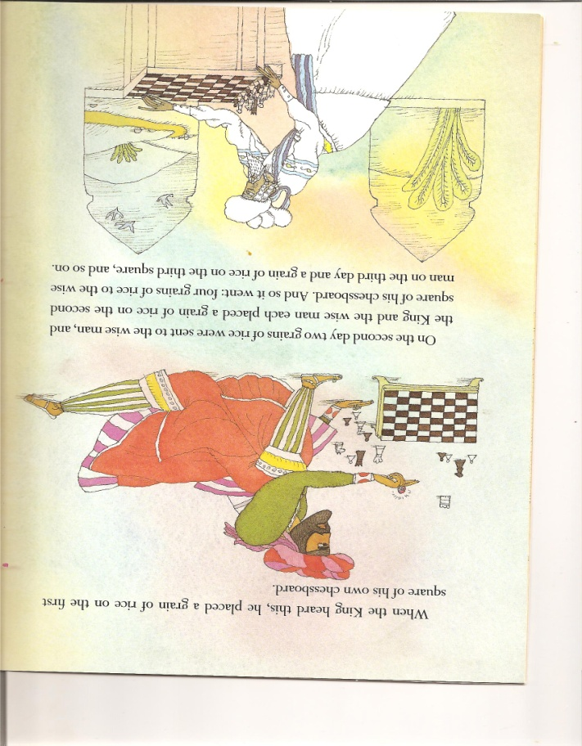
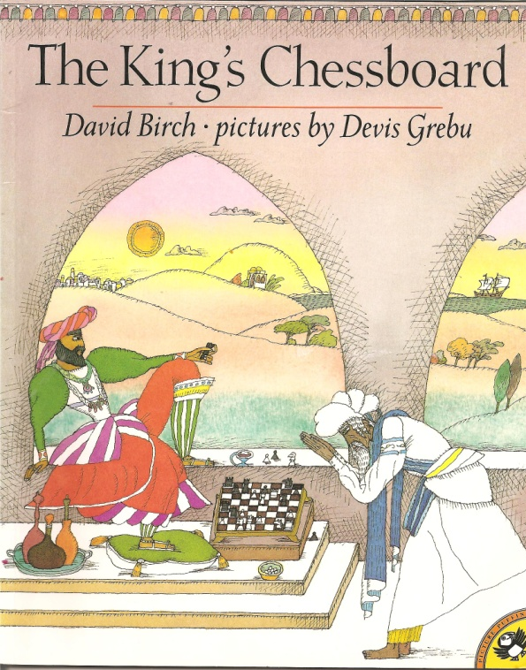
Learning Objectives
* to understand exponents
Story Summary
This story is about a wise man who outwits the king by using a mathematic concept. How many grains of rice will the king have if he puts a grain of rice on the chessboard and doubles it each space?

Slide 16
Here is the answer to the problem: compute the exponential expression: 2⁶⁴
2⁶⁴ = 18446744073709551616, that is to say 18,446,744,073,709,551,616 is read in English as:
"eighteen quintillion, four hundred forty-six quadrillion, seven hundred forty-four trillion,
seventy-four billion, seven hundred nine million, five hundred fifty-one thousand, six hundred sixteen."
In order to put this large number in perspective, let's pretend that we can spend $1,000,000 per second for each second that we have been alive.
If you are thirty-seven years old now, then you are 37x365 days old, or 13,505 days old. Now multiply this by the number of hours in a day:
13,505 x 24 is 324,120 hours old. Multiply this result by the number of minutes in an hour: 324,120 x 60 = 19,447,200 minutes old. Finally, multiply this result by the number of seconds in a minute: 19,447,200 x 60 = 1,166,832,000 seconds old (about 1.2 billion!).
Now, how much money does this represent? Simply (!) multiply this result by $1,000,000; but, this is VERY easy because you should recall that a one (1) followed by ANY number of zeros (0) is a "power of ten", and multiplying a number by a power of ten is explained in the text as follows:
in order to multiply, say, 1,234 by 100, simply add two zeros to 1234, or 123400 = 123,400. Similarly, 58 x 1000 = 58000, or 58,000. So, our final answer would be: $1,166,832,000,000,000. This number is about 16,000 times SMALLER than 2⁶⁴, in other words, it would take ANOTHER 584,905 years of spending money at the rate of $1,000,000 per second in order to spend $18,446,744,074,709,551,616.
Provide a chess board and some rice. Let them see the first few squares of rice as they pile up on just a few spaces on the board.

Slide 17
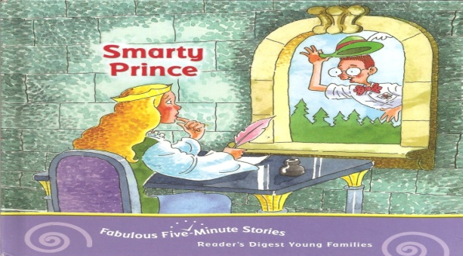
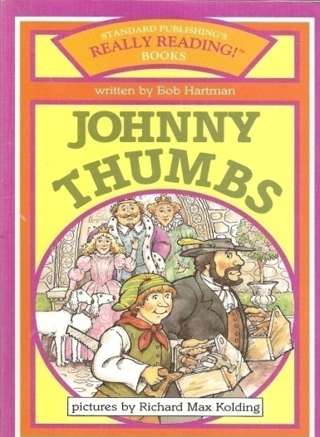
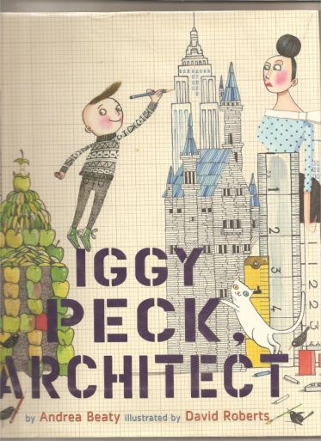
Learning Objectives
*brainstorming and building
Smarty Prince - How will the prince rescue the princess from the tower?
Iggy Peck Architect -
Some kids sculpt sand castles. Some construct block towers, but none are better than Iggy Peck. Iggy has to work together with his classmates to rescue his teacher by building a bridge out of various materials.
Johnny Thumbs – Johnny competes to build the best house for the princess.
Activity: Use a variety of materials to build a bridge or a tower. Do this individually or time groups to see who comes up with the best in a small amount of time.
Try building towers with food items, wooden sticks and various paper items, foam sponges, plastic bottles and containers, etc.

