Slide 1
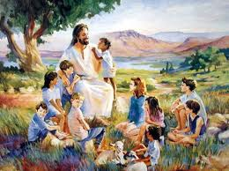
Valuable to Him
Presented by: Cyndi Summers

Slide 2
Valuable to Him
By Max Lucado
“Be happy with me because I found my lost sheep.” Luke 15:6
When Jesus told the story of the missing sheep, some of the people who were listening wiped away a tear because they knew how it feels to be lost among the crowd. Jesus wanted us to understand that we have a Father who sees and cares for each one of his children—that we are all equally valuable to him.

Slide 3
http://www.youtube.com/watch?v=n2VNVlE1p4Y&feature=related
We’re talking about God today.

Slide 4
http://www.youtube.com/watch?v=MYXJlfcfFKU

Slide 5
God says not only are you accepted, you’re valuable. How much do you think you’re worth?
You can be rich or poor but it has nothing to do with your value as a person. You have been bought and paid for by Christ. You belong to Jesus. How much does that make you worth? God exchanged his own Son for you! The cross proves your value. Jesus didn’t die for junk. You are incredibly valuable. Nobody has ever paid a greater price than God paid for you. You are acceptable and you are valuable!

